Slide 1
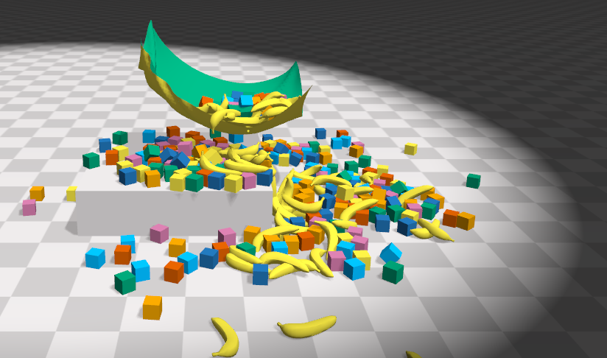
Collision Response
Interior Point Methods
Impact Zone Optimization
Intersection Elimination

Slide 2

Outline Today
Collision Detection Pipeline
Spatial Hashing
Gilbert–Johnson–Keerthi (GJK)
Pair Condidates
Colliding Pairs
$${\{x,x}^{new}\}$$
or
or
Bounding Volume Hierarchy (BVH)
Separating Axis Theorem (SAT)
Broad-Phase Collision Culling
Narrow-Phase Collision Test

Slide 3
Outline Today
A Practical System
Interior Point Method
Impact Zone Optimization
Colliding Pairs
Rigid Impact Zones
Intersection Elimination
For Cloth Simulation

Slide 4
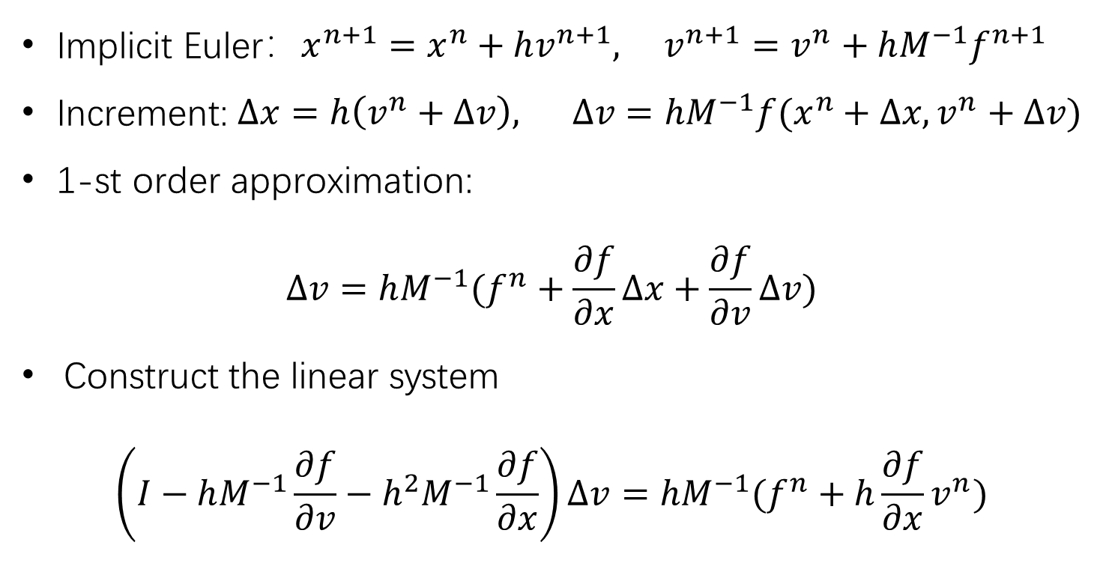

Background – Implicit Simulation
Explicit methods calculate the state of a system at a later time from the state of the system at the current time, while implicit methods find a solution by solving an equation involving both the current state of the system and the later one.
Implicit Euler：$x^{n+1}=x^{n}+hv^{n+1}, v^{n+1}=v^{n}+hM^{−1}f^{n+1}$
Increment: $Δx=h\left(v^{n}+Δv\right), Δv=hM^{−1}f(x^{n}+Δx, v^{n}+Δv)$
1-st order approximation:
$$Δv=hM^{−1}(f^{n}+\frac{∂f}{∂x}Δx+\frac{∂f}{∂v}Δv)$$
Construct the linear system
$$\left(I−hM^{−1}\frac{∂f}{∂v}−h^{2}M^{−1}\frac{∂f}{∂x}\right)Δv=hM^{−1}(f^{n}+h\frac{∂f}{∂x}v^{n})$$
$$\frac{∂f}{∂v}→−\frac{∂^{2}E}{∂x∂v}$$
$$\frac{∂f}{∂x}→−\frac{∂^{2}E}{∂x^{2}}$$

Slide 5
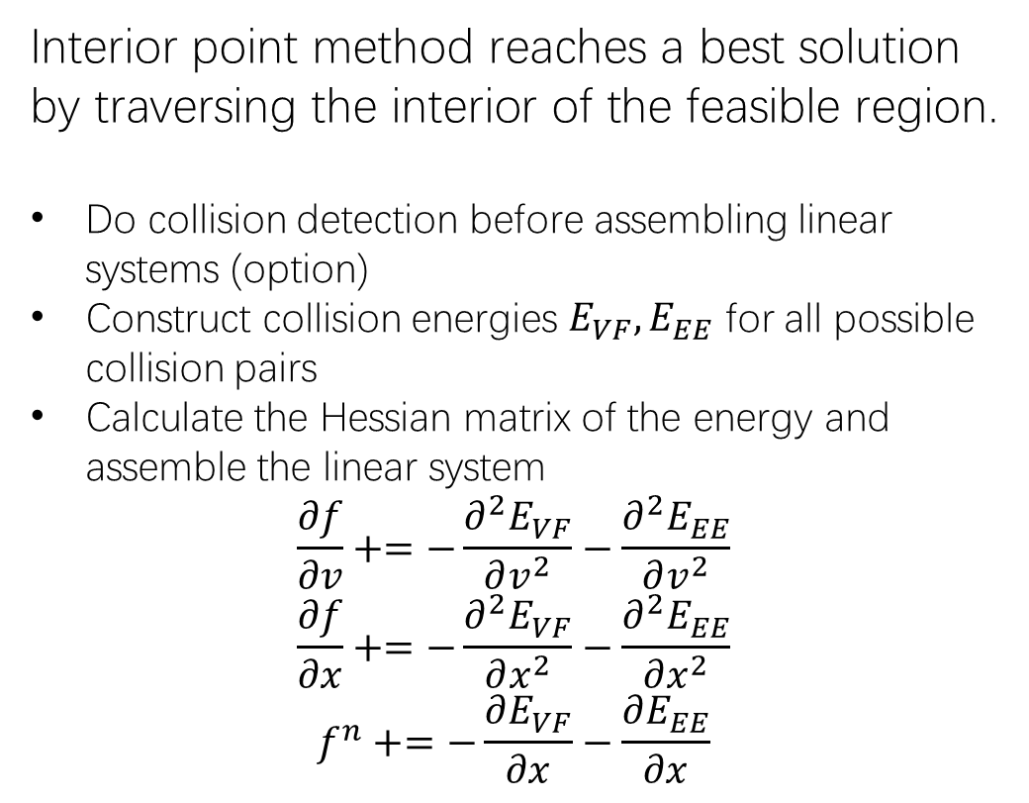

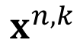
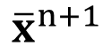
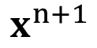
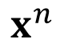
Interior Point Method
Given the calculated next state${ x}^{n}$, we want to update it into ${\overline{x}}^{n+1}$, such that the path from${ x}^{n}$ to ${\overline{x}}^{n+1}$ is intersection-free.
Interior point method reaches a best solution by traversing the interior of the feasible region.
Do collision detection before assembling linear systems (option)
Construct collision energies $E_{VF},E_{EE}$ for all possible collision pairs
Calculate the Hessian matrix of the energy and assemble the linear system
$$\frac{∂f}{∂v}+=−\frac{∂^{2}E_{VF}}{∂v^{2}}−\frac{∂^{2}E_{EE}}{∂v^{2}}$$
$$\frac{∂f}{∂x}+=−\frac{∂^{2}E_{VF}}{∂x^{2}}−\frac{∂^{2}E_{EE}}{∂x^{2}}$$
$$f^{n}+=−\frac{∂E_{VF}}{∂x}−\frac{∂E_{EE}}{∂x}$$
$$x^{n+1}$$
$${\overline{x}}^{n+1}$$
$$x^{n}$$
$$x^{n,k}$$
intersection-free

Slide 6
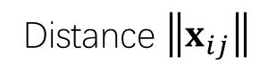

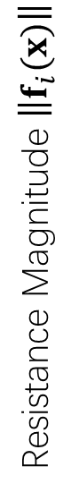
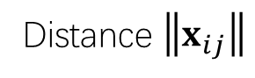

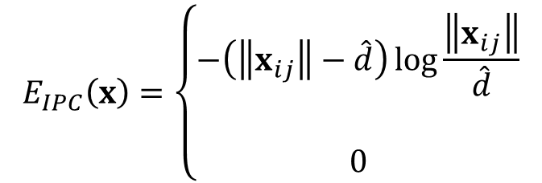


Log-Barrier Interior Point Method
For simplicity, let’s consider the Log-barrier repulsion between two vertices.
$$E\left(x\right)=−ρ\log\left\|x_{ij}\right\|$$
Infinite resistance as distance ->0
$$f_{i}(x)=−∇_{i}E=ρ\frac{x_{ij}}{{\left\|x_{ij}\right\|}^{2}}$$
Resistance Magnitude $\left\|f_{i}(x)\right\|$
Resistance Magnitude $\left\|f_{i}(x)\right\|$
$$f_{j}(x)=−∇_{j}E=−ρ\frac{x_{ij}}{{\left\|x_{ij}\right\|}^{2}}$$
Local support
(IPC, [Wu et al. 2020])
$$E_{IPC}\left(x\right)=\left\{\begin{aligned}−\left(\left\|x_{ij}\right\|−\hat{d}\right)\log{\frac{\left\|x_{ij}\right\|}{\hat{d}}} \\ \\ 0\end{aligned}\right.$$
Distance $\left\|x_{ij}\right\|$
Distance $\left\|x_{ij}\right\|$

Slide 7
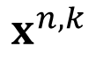

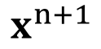
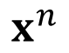
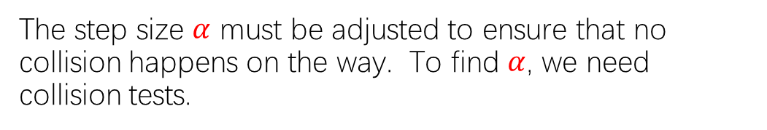
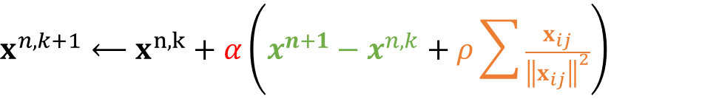

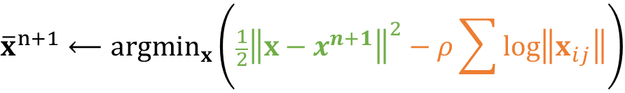
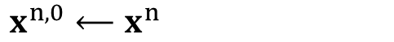
Log-Barrier Interior Point Method
We can then formulate the problem as:
$${\overline{x}}^{n+1}⟵{argmin}_{x}\left({\frac{1}{2}\left\|x−x^{n+1}\right\|}^{2}−ρ\sum{\log\left\|x_{ij}\right\|}\right)$$
$$x^{n+1}$$
Gradient Descent:
$$x^{n,0}⟵x^{n}$$
For $k=0…K$
$$x^{n, k+1}⟵x^{n,k}+α\left(x^{n+1}−x^{n,k}+ρ\sum{\frac{x_{ij}}{{\left\|x_{ij}\right\|}^{2}}}\right)$$
$$x^{n,k}$$
$$x^{n}$$
$${\overline{x}}^{n+1}⟵x^{n, k+1}$$
intersection-free
The step size $α$ must be adjusted to ensure that no collision happens on the way. To find $α$, we need collision tests.

Slide 8
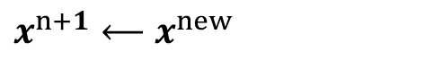
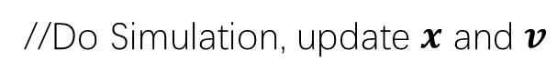
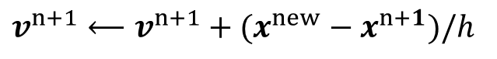
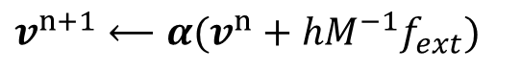

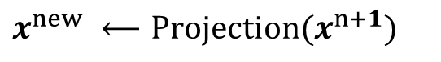
Background – Position Based Dynamics
Position based dynamics (PBD) is based on the projection function.
The stiffness behavior, i.e., how tightly constraints are enforced, is subject to non-physical factors.
The number of iterations
The mesh resolution
The velocity update following projection is important to dynamic effects.
This method is applicable to other constraints as well, including triangle constraints, volume constraints, and collision constraints.
To implement these constraints, simply define their projection functions.
A PBD Simulator
//Do Simulation, update $x$ and $v$
$$v^{n+1}⟵α(v^{n}+hM^{−1}f_{ext})$$
$$x^{n+1}⟵x^{n}+v^{n+1}$$
//Now PBD starts.
$$x^{new} ⟵Projection(x^{n+1})$$
$$v^{n+1}⟵v^{n+1}+(x^{new}−x^{n+1})/h$$
$$x^{n+1}⟵x^{new}$$

Slide 9
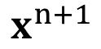
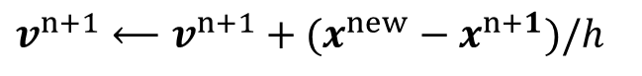
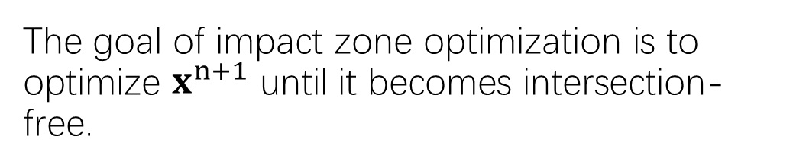
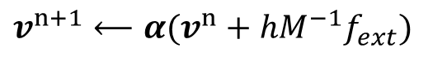
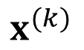

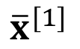
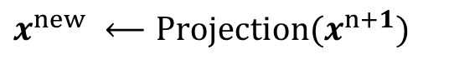
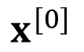
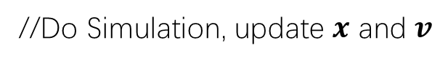
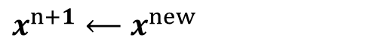
Impact Zone Optimization
Given the calculated next state${ x}^{n}$, we want to update it into ${\overline{x}}^{n+1}$, such that the path from${ x}^{n}$ to ${\overline{x}}^{n+1}$ is intersection-free.
The goal of impact zone optimization is to optimize $x^{n+1}$ until it becomes intersection-free.
$$x^{n+1}$$
A PBD Simulator
$$x^{(k)}$$
//Do Simulation, update $x$ and $v$
$${\overline{x}}^{[1]}$$
$$v^{n+1}⟵α(v^{n}+hM^{−1}f_{ext})$$
$$x^{[0]}$$
$$x^{n+1}⟵x^{n}+v^{n+1}$$
//Now PBD starts.
Collision
Detection
intersection-free
$$x^{new} ⟵Projection(x^{n+1})$$
$$v^{n+1}⟵v^{n+1}+(x^{new}−x^{n+1})/h$$
$$x^{n+1}⟵x^{new}$$

Slide 10
Impact Zone Optimization
Given the calculated next state${ x}^{n}$, we want to update it into ${\overline{x}}^{n+1}$, such that the path from${ x}^{n}$ to ${\overline{x}}^{n+1}$ is intersection-free.
The goal of impact zone optimization is to optimize $x^{n+1}$ until it becomes intersection-free.
$$x^{n+1}$$
$$x^{(k)}$$
Vertex-face pair: vertex-face distance constraints
Edge-edge pair: edge-edge distance constraints
Special case: Capsule constraints, etc.
$${\overline{x}}^{[1]}$$
$$x^{[0]}$$
intersection-free

Slide 11

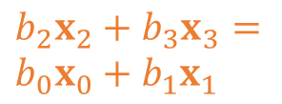
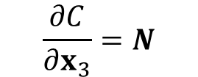
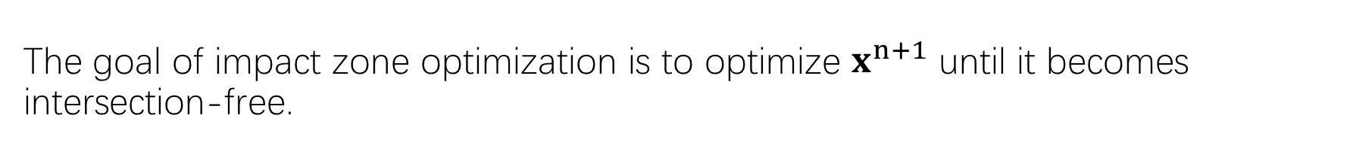
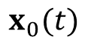
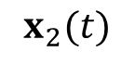
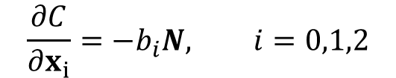
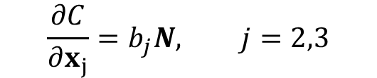
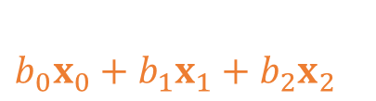
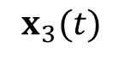
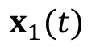
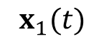
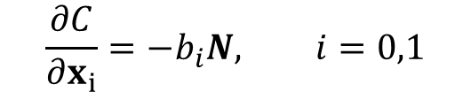
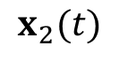
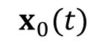

Impact Zone Optimization
The goal of impact zone optimization is to optimize $x^{n+1}$ until it becomes intersection-free.
$$C\left(x\right)=(x_{3}−b_{0}x_{0}−b_{1}x_{1}−b_{2}x_{1})∙N≥0$$
$$C\left(x\right)=\left({b_{2}x}_{2}+b_{3}x_{3}−b_{0}x_{0}−b_{1}x_{1}\right)∙N≥0$$
$$\frac{∂C}{∂x_{i}}=−b_{i}N, i=0,1,2$$
$$\frac{∂C}{∂x_{i}}=−b_{i}N, i=0,1$$
$$\frac{∂C}{∂x_{3}}=N$$
$$\frac{∂C}{∂x_{j}}=b_{j}N, j=2,3$$
$$N$$
$$N$$
$$x_{2}(t)$$
$$x_{2}(t)$$
$$b_{0}x_{0}+b_{1}x_{1}+b_{2}x_{2}$$
$$x_{0}(t)$$
$$x_{0}(t)$$
$$x_{1}(t)$$
$${b_{2}x}_{2}+b_{3}x_{3}=$$
$$b_{0}x_{0}+b_{1}x_{1}$$
$$x_{1}(t)$$
$$x_{3}(t)$$
Vertex-Face Pair
Edge-Edge Pair

Slide 12

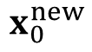
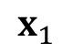
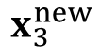
















Impact Zone Optimization
The goal of impact zone optimization is to optimize $x^{n+1}$ until it becomes intersection-free.
$$λ=−\frac{C(x)}{{\left|∇C\left(x\right)\right|}^{2}}$$
$$Δx_{i}=\frac{λ}{m_{i}}\frac{∂C}{∂x_{i}}$$
$$C\left(x+Δx\right)=0$$
$$C\left(x\right)+∇C\left(x\right)Δx=0$$
$$Δx=λ∇C(x)$$
$$N$$
$$x_{2}$$
$$x_{2}^{new}$$
$$x_{3}^{new}$$
$$N$$
$$x_{0}$$
$$x_{2}^{new}$$
$$x_{0}$$
$$x_{3}^{new}$$
$$x_{1}$$
$$x_{1}$$
$$x_{2}$$
$$x_{3}$$
$$x_{0}^{new}$$
$$x_{1}^{new}$$
$$x_{0}^{new}$$
$$x_{3}$$
$$x_{1}^{new}$$
Vertex-Face Pair
Edge-Edge Pair

Slide 13








Pros and Cons
Slow.
Far from solution.
All of the vertices.
Cautiously by small step sizes.
Always succeed.
Fast.
Close to solution.
Only vertices in collision (impact zones).
Can take large step sizes.
May not succeed.
$$x^{n+1}$$
$$x^{n+1}$$
$$x^{(k)}$$
$${\overline{x}}^{n+1}$$
$${\overline{x}}^{[1]}$$
$$x^{n}$$
$$x^{n,k}$$
$$x^{[0]}$$
intersection-free
intersection-free

Slide 14


Rigid Impact Zones
The rigid impact zone method simply freezes vertices in collision from moving in their pre-collision state. It’s simple and safe, but has noticeable artifacts.

Slide 15
Outline Today
A Practical System
Interior Point Method
End
Impact Zone Optimization
Colliding Pairs
Rigid Impact Zones
End
no more collision
End
Intersection Elimination
For Cloth Simulation

Slide 16

Intersection Elimination

Slide 17


Intersection Elimination
Let’s consider how to eliminate existing intersections, but without using any collision history.
Such a method is useful when there are already intersections in simulation, due to:
Past collision handling failures
Intense user interaction
In this case, we don’t require the simulation is to always intersection-free.
Discrete Collision Detection of $x^{n}$
Eliminating intersections in $x^{n}$

Slide 18
Intersection Elimination
Eliminating cloth-volume and volume-volume intersections is straightforward: simply pushing vertices/edges in the volume out.
Volume-volume intersection
Cloth-volume intersection

Slide 19
Intersection Elimination
The situation is complicated in cloth-cloth intersection, since we don’t have a clear definition of inside and outside.
Baraff et al. used flood-fill to segment cloth into regions and decided which region is in intersection. (Cannot handle boundary well.)

Slide 20

Intersection Elimination
Baraff et al. used flood-fill to segment cloth into regions and decided which region is in intersection. (Cannot handle boundary well.)

Slide 21



Intersection Elimination
Volino and Magnenat-Thalmann proposed to untangle cloth by reducing the intersection contour.
Their method can handle boundaries, but it doesn’t always work.

Slide 22
Reference and Futher Readings
GAMES103-基于物理的计算机动画入门 [Link]
Incremental Potential Contact: Intersection- and Inversion-free Large Deformation Dynamics [Link]
Position Based Dynamics [Link]
Untangling Cloth [Link]
Resolving surface collisions through intersection contour minimization [Link]
All relevant files (ppt, pdf, image, code, video):
https://github.com/LILKOTYO/Lab-Presentation/tree/master/20230522_Collision_Handling

